Slide 1

ET2223 Microprocessors Microcontrollers & Embedded Systems
Embedded Systems Design
Dr Budditha Hettige
Department of Computer Engineering
General Sir John Kotelawala Defence University

Slide 2
Embedded Systems Design
Characteristics
Embedded systems are designed for specific tasks and are single functioned
Some of them don’t have any external interface at all, some may contain complex interfaces. It’s based on the requirements of the system
Some systems may provide user interfaces directly or through serial or network connection which reduces the overall cost of the system by avoiding displays and input interfaces
Embedded systems are typically designed to meet real-time constraints
They are designed with high optimization for memory, power usage, execution time, dimensions, weight, and cost
Embedded system use a few resources, so developing a system will be a challenging task
The system should be highly reliable; it is not designed for repairs and cannot be shut down for safety reasons.

Slide 3
Embedded Systems – Design Concepts
Embedded system today are characterized by rapidly expanding functionality and shrinking time to market.
Major design challenges are
  Complexity - Hardware capabilities (and associated software demands) are growing faster than designers can keep up.
  Heterogeneity - Systems are made out of vide variety of components

Slide 4
Embedded Systems - design challenges
Coping with complexity and heterogeneity
  Abstraction
■
■
Intellectual property (IP) re-use
Pre-designed hardware modules – either soft cores (e.g. source, netlists) or hard cores (transistor or other layout)
Range in functionality from simple multipliers, to memories, to interfacing logic, to processors
Pre-designed software as well (e.g. drivers, OS) Typically follow some set interfacing standards
■
■
○
Modularity
■
■
Well defined interfaces and functionality
Each block or module can be designed relatively independent from each other
Enables parallelisation of the design process

Slide 5
ES - Design Concepts
Coping with complexity and heterogeneity
  Platform based design
    Design philosophy that focuses on IP-centric design and reuse
    Platform: a customizable design (may call as partial design) for a particular type of system, consisting of embedded processors, peripherals, and software
    Leads to not only Abstraction and modularity but to Accuracy and Efficiency too.
    Platforms are IP at next level of abstraction

Slide 6
Embedded Systems - Design Concepts
Alternatives to platforms
  General Purpose Architectures
    May require much more area to accomplish the same task.
    Often much less energy-efficient.
  Reconfigurable systems
    Good for pieces of the system, but tough to compete with software for miscellaneous tasks.
    Often FPGA based

Slide 7
Embedded Systems - Design Concepts
Standards and platforms
  Many high-volume markets are standards-driven: Wireless,multimedia, networking.
  Standard defines the basic I/O requirements.
  Systems house chooses implementation of standards functions: improved quality, lower power, etc.
  Product may be differentiated by added features: cell phone user interface.
  Standards encourage platform-based design.

Slide 8
Embedded Systems - Design Concepts
Platform vs. full-custom designs
  Platform has many fewer degrees of freedom:
    harder to differentiate;
    can analyze design characteristics.
  Full-custom:
    extremely long design cycles;
    may use less aggressive design styles if you can’t reuse some pieces.

Slide 9
Embedded Systems - Design Concepts
●

Slide 10
Embedded Systems - Design Concepts
Semiconductor vs. systems house
  Semiconductor house designs the platform.
  Systems house customizes the platform for its system:
    customization may be done in-house or by contractor.
Requirement Analysis
  Functional requirements
    What the system should do
  Non - Functional Requirements
    How the system works
Performance – for example Response Time, Throughput, Utilization, Static Volumetric
Scalability, Capacity, Availability, Reliability, Recoverability, Maintainability, Serviceability,
Security, Regulatory, Manageability, Environmental, Data Integrity, Usability, Interoperability
●
●

Slide 11
Embedded Systems - Design Concepts
Platform design challenges
  Does it satisfy the application’s basic requirements?
  Is it sufficiently customizable? And in the right ways?
  Is it cost-effective?
  How long does it take to turn a platform into a product?
Platform design methodology
  Size the problem.
    How much horsepower? How much power?
  Develop an initial architecture.
  Evaluate for performance, power, etc.
  Evaluate customizability.
  Improve platform after each use.

Slide 12

Embedded Systems - Design Concepts
Platform use challenges
○
○
○
How do I understand the platform’s design? How do I modify it to suit my needs?
How do I optimize for performance, power, etc.?
Platform use methodology
Start with reference design, evaluate differences required for your features.
Evaluate hardware changes.
Implement hardware and software changes in parallel. Integrate and test.
How do I choose a platform?
  evaluate aspects of the platform critical to my product’s requirements

Slide 13
Embedded Systems - Design Concepts
Platforms rely on embedded processors:
○
○
○
can be customized through software
can put considerable design effort into the CPU.
Many platforms are complex heterogeneous multiprocessors.
Software and hardware reuse
Want to reuse as many hardware components as possible: known performance, power.
Want to use software libraries where possible. RTOS simplifies design of multi-tasking systems.
○
○
But how you do it?
○
Do we use a disciplined, analytical process to create a platform that can be used for a series of designs?
Do we grab the last similar design and start hacking?
○

Slide 14
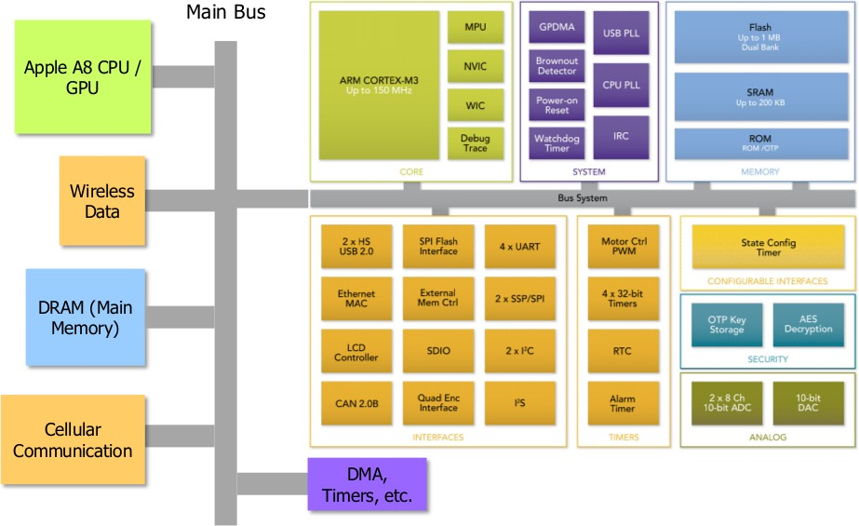
Embedded Systems - Design Concepts
Platform example - iPhone 6

Slide 15
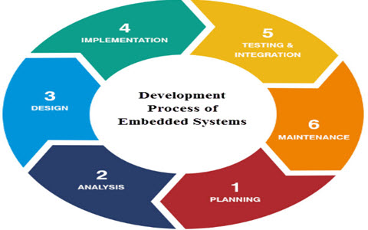

Slide 16
ES Design Process Activities
Design Metrics / Design Parameters of an Embedded System | Function
Power Dissipation | Always maintained low
Performance | Should be high
Process Deadlines | The process/task should be completed within a specified time.
Manufacturing Cost | Should be maintained.
Engineering Cost | It is the cost for the edit-test-debug of hardware and software.

Slide 17
ES Design Process Activities
Size | Size is defined in terms of memory RAM/ROM/Flash Memory/Physical Memory.
Prototype | It is the total time taken for developing a system and testing it.
Safety | System safety should be taken like phone locking, user safety like engine break down safety measure must be taken
Maintenance | Proper maintenance of the system must be taken, in order to avoid system failure.
Time to market | It is the time taken for the product/system developed to be launched into the market.

Slide 18
ES Design Examples
Automatic chocolate vending machine (ACVM)
Digital camera
Smart card
Mobile phone
Mobile computer..etc.

Slide 19
Design Steps
Identify Requirements
Identify Input, Output and Process
Select Hardware Component
Create Cost Estimate
Create Prototype Design
Create Code (Software)
Test the system
Evaluate the system
Make final product

Slide 20
Example
Automatic Chocolate Vending Machine (ACVM)
Design Steps - Requirements
  Inputs
  Coins, user selection.
  An interrupt is generated at each port whenever a coin is inserted.
  A separate notification is sent to each port.
  Outputs
  Chocolate
  Refund
  A message is displayed on LCD like date, time, welcome message.

Slide 21
System Functions
Using a graphical user interface, the child commands to the system which chocolate the child wants to purchase.
Where the graphical user interface has an LCD, keypad, touch screen.
The machine delivers the chocolate when the child inserts the coin if the coins inserted are excess than the actual cost of selected chocolate. The ACVM machine refunds the money back.
Using a Universal synchronous bus, the owner of the ACVM can keep track of client location.
An LCD present here displays the messages like cost, time, welcome..etc. A port delivery exists where the chocolates are collected.

Slide 22
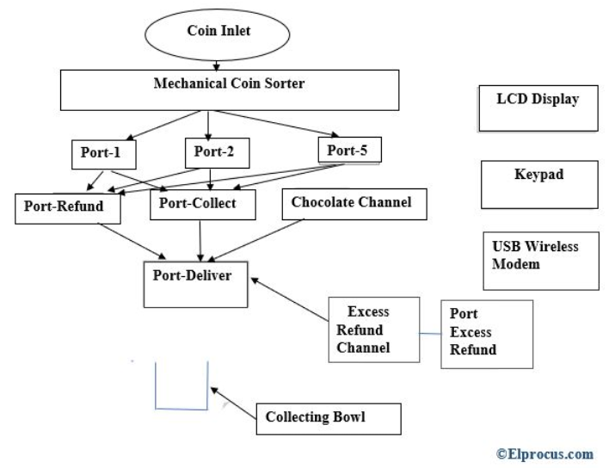
Specifications
when the child inserts the coin. The coins get segregated according to the ports presented.

Slide 23
Hardware
ACVM hardware architecture has the following hardware specifications
Microcontroller 8051
64 KB RAM and 8MB ROM
64 KB Flash memory
Keypad
Mechanical coin sorter
Chocolate channel
Coin channel
USB wireless modem
Power supply

Slide 24
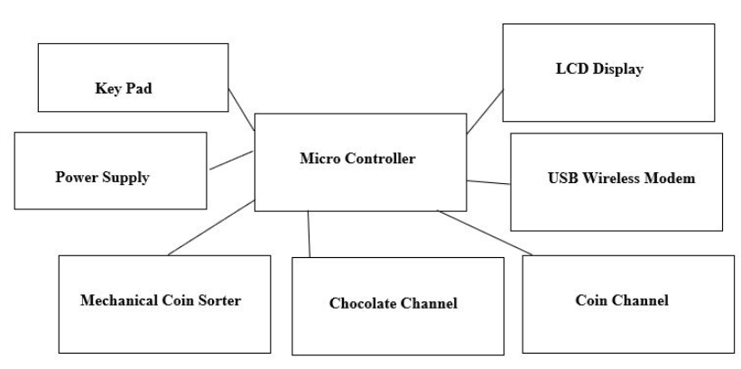
Software of the ACVM
Many programs have to be written so that they can be reprogrammed when required in RAM /ROM like,

Slide 25
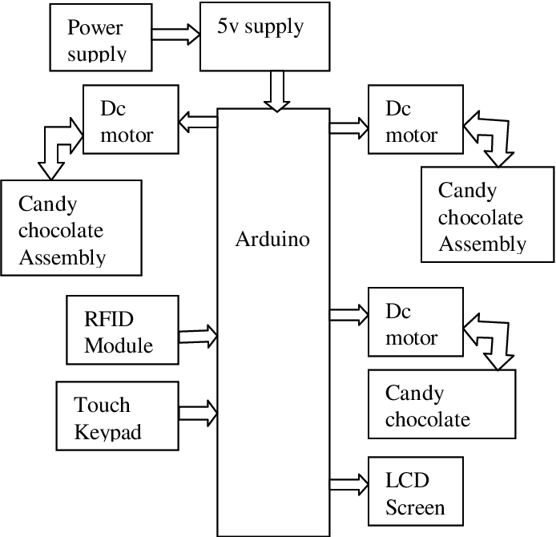
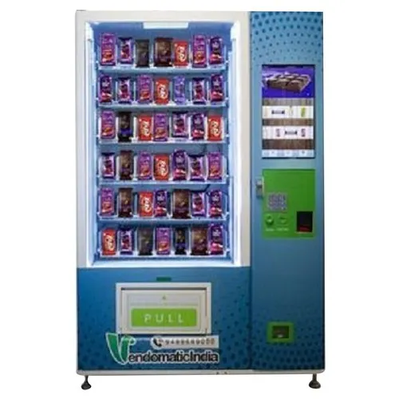
Block Diagram

Slide 26
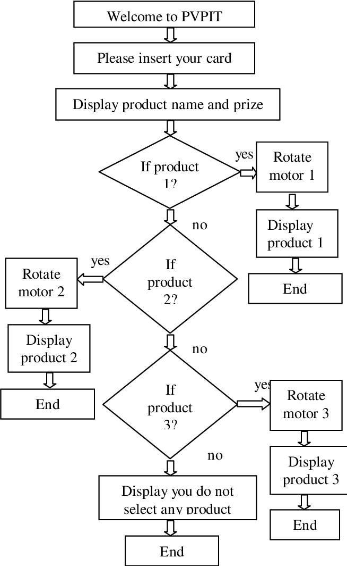
Flow chart

Slide 27
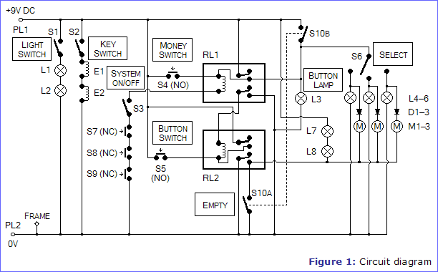
Circuit Diagram

Slide 28
Challenges in ES
Environment adaptability
Power consumption
Area occupied
Packaging and integration
Updating in hardware and software
Security
There are various challenges the designers face while testing the design like
  Embedded hardware testing,
  Verification stage,
  Validation Maintainability.

Slide 29
Activity #1
Create a simple tea providing machine for KDU
  Identify Requirements
  Identify Input, Output and Process
  Select Hardware Component
  Create Cost Estimate
  Create Prototype Design
  Create Code (Software)
  Test the system
  Evaluate the system
  Make final product
Discuss How to automate this machine as a smart machine

Slide 30
Activity #2
Design and develop Simple timer as a low-cost product
Consider the ES design steps and explain each steps briefly

